Slide 1
Katlabodi Village Survey
A Field Assessment of Livelihood, Infrastructure and Agricultural Systems
Represented by : VNIT Nagpur Team
Notes:
Seven-slide field assessment of Katlabodi: demographics and income, infrastructure and governance gaps, agricultural profile, the ecological shift in pest concentration, market dynamics, water and energy bottlenecks, and untapped development potential.

Slide 2


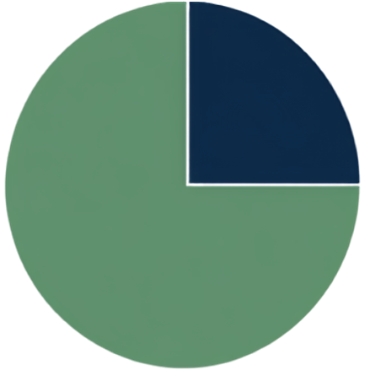









Demographics & Economic Baseline
₹50,000
25%
Average household income per year
Other sectors
100%
75%
₹15,000
0%
Agriculture
Average salary
Households own a smartphone
Internet or cellular tower coverage
Predominantly Adivasi (tribal) community with limited connectivity and constrained incomes.

Slide 3










Infrastructure & Governance Deficit
0
0
0
0
%
Healthcare VOID
Connectivity Crisis
Scheme Penetration
Awareness Gap
No hospitals for humans or animals; complete reliance on outside private doctors.
Zero penetration across all government sectors (water, crops, seeds).
Subsidies exist on paper, but villagers have absolute zero awareness of how to access them.
Zero cellular network; Gram Panchayat BBNL Wi-Fi is non-functional.

Slide 4

























Agricultural Profile
MAJOR CROPS CULTIVATED
Wheat
Cotton
Tur Dal
Chana
Jawari
SOIL DIVERSITY
ADVISORY RELIANCE AND RISK
No formal knowledge
Local vendor informal advice
Potential risk
Black
Red
Bhasma
White
Yellow
Zero awareness on optimal seeds and modern fertilizers. Farmers depend entirely on unverified advice.
The area previously hosted a local mine.

Slide 5



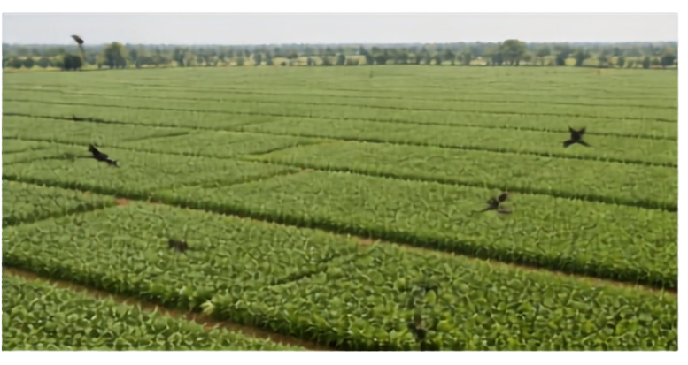
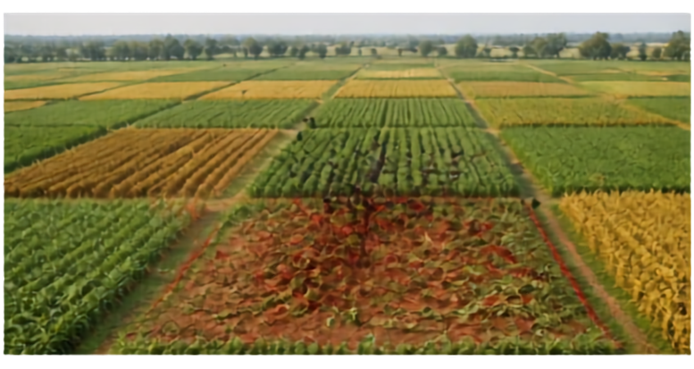





Ecological Shift
Crop diversity has concentrated pest pressure and magnified losses on a few farms.
BEFORE
NOW
All farms grew the same crop.
Bird and wildlife damage was evenly distributed.
Diverse crops in the same season.
Pests target preferred crops, causing severe localised loss.
Declining
soil fertility
+
labor shortages
Crop
diversification
Pest
concentration
Localized
devastating loss

Slide 6














Market Dynamics & Agricultural Risks
Local market dependency
Crops and daily milk (60-70 liters) are sold exclusively in local markets.
Crops & Milk
X
Transport barrier to growth
60-70
liters daily
Local Markets
High transport costs negate profits
Nagpur Mandis
Farmers avoid Nagpur mandis due to high transport costs that erase profits.
Seasonal fodder economics
Monsoon / Winter
Summer
Seasonal fodder impact
Key agricultural risks
Free forest grazing
Fodder cost up to
₹1 Lakh
Monsoon / Winter
Summer
High vulnerability to risks
Free forest grazing
vs
Fodder cost up to
Erratic rainfall and wildlife damage can devastate crops and plantations.
₹1 Lakh
Erratic
rainfall
Wildlife damage (e.g., monkey impact on mango plantations)

Slide 7










Water & Energy Bottlenecks
WATER DEPENDENCY
POWER SUPPLY
WHY SOLAR SCHEME FAILED
₹
25%
Village electricity
100%
unattainable
upfront cost for farmers
24/7
groundwater dependency
supply
overly complex bureaucratic paperwork
0%
Agricultural electricity
8 hrs
insufficient solar voltage for heavy pumps running 8 continuous hours
rainwater harvesting infrastructure
per day in shifts

Slide 8



















Untapped Potential & Strategic Opportunities
Strong Adoption Mindset
Available Workforce
Local women are eager
to dedicate 4–5 hours
daily to micro-industries
like agarbatti manufacturing.
Villagers are receptive
to new crops and methods
when clear ROI is shown.
A foundation
of local strengths
ready to be
converted into
sustainable growth
Waste-to-Wealth Opportunity
Abundant
Bio-Resources
Livestock generates minimum
Local livestock population
150
~1,000
tractorloads of dung
annually, enabling biogas
or organic fertilizer
micro-industries.
(cows, buffaloes, goats).

